Slide 1


DWH & ETL
PROCESS
By: Ali Osseili and Saleh El Moukahal

Slide 2


Meet Us
Saleh El Moukahal
Ali Osseili

Slide 3


Overview
Understanding the data
DWH designing
Data Extraction
Data Transformation
Loading
Data Validation

Slide 4
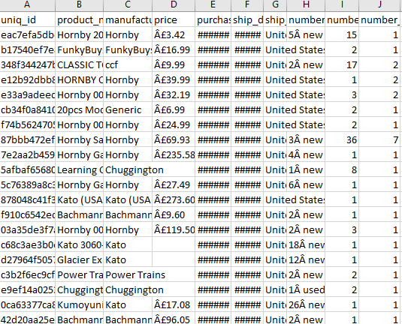
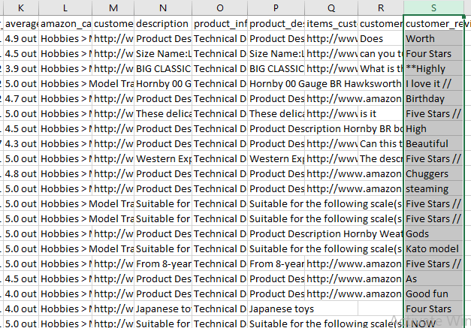
Understanding Data
Our dataset is constituted of 19 columns in one table, so we had to figure out how to split these columns into dimension tables for an efficient data warehouse design.

Slide 5


DWH Design
The schema follows a star schema design, with f_products as the central fact table surrounded by dimension tables. This structure allows for efficient querying and analysis of product-related data across various dimensions like customer reviews, categories, countries, and manufacturers.
Next page

Slide 6
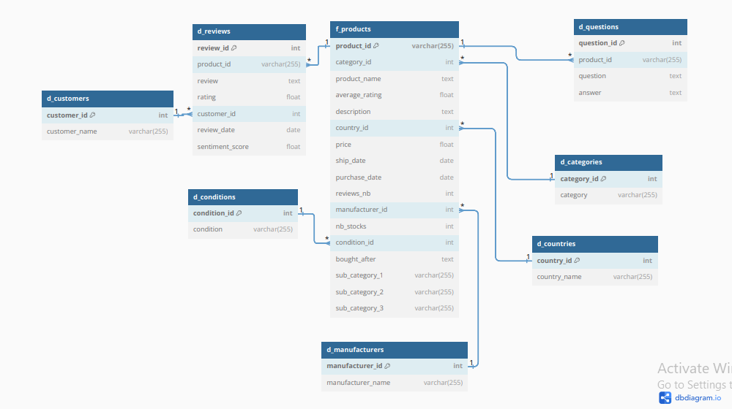

Slide 7


Data Extraction
For this scenario, we're using Python to handle the extraction phase.
Pandas to be specific did the extraction of data from the csv file.

Slide 8

Data Transformation
In the transformation phase, major changes have been made, null values have been filled, data types changed to be easier for analysis and column have been splat into numerous other columns.
Reviews
Categories
Stocks
Customers Reviews being concatenated with the rating, review date and the customer name
Categories and almost 3 levels of sub-categories were split into 4 columns
Stocks column cleaned from useless characters then splatted into two column

Slide 9
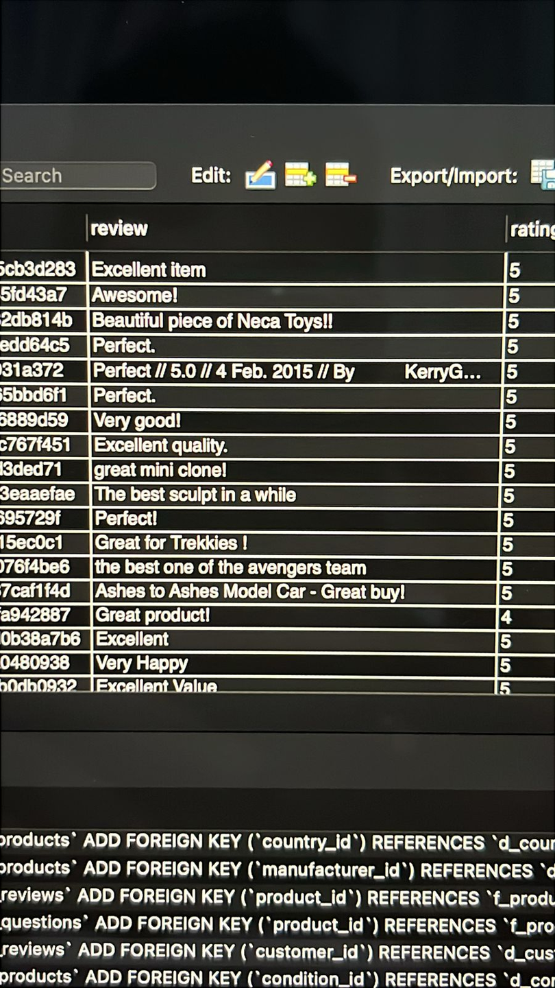
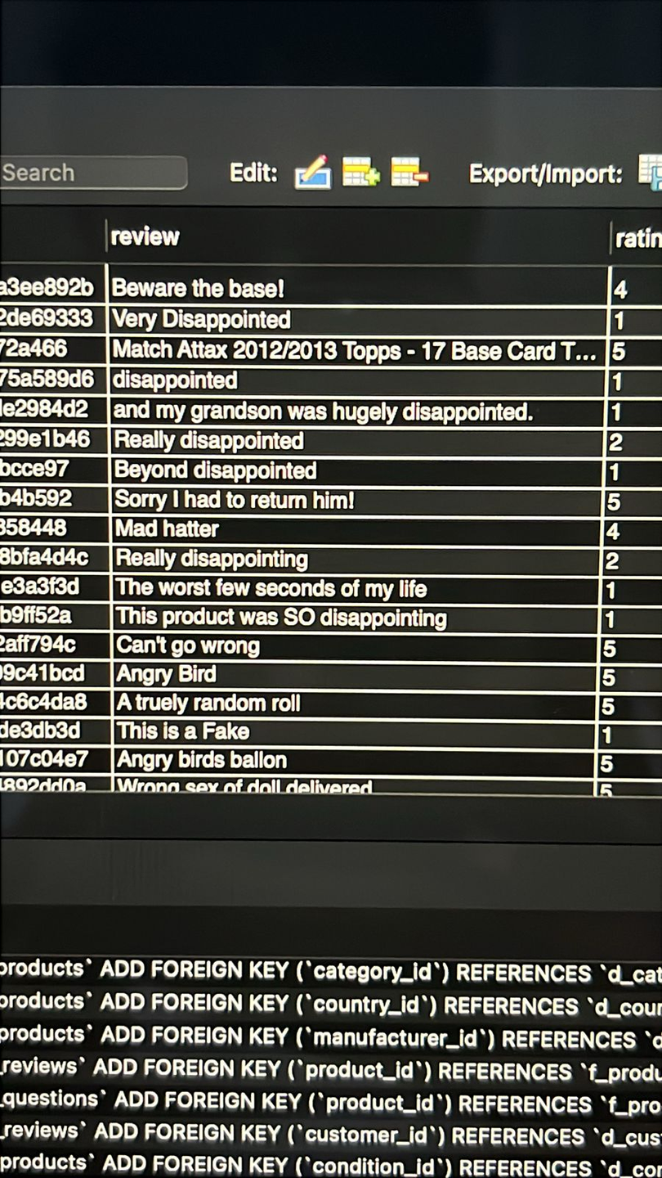
Sentiment Analysis
Sentiment analysis of customer reviews using Natural Language Processing (NLP) involves analyzing text data to determine the sentiment expressed within each review

Slide 10
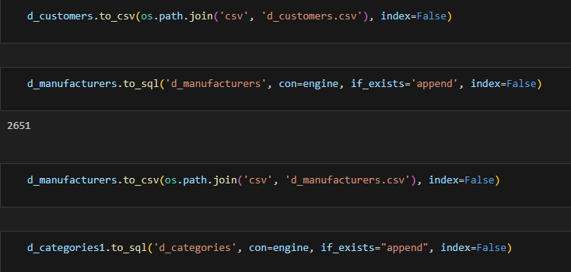
Loading the Data
Fact Table (f_products): Contains core metrics and foreign keys to dimension tables.
Dimension Tables:
d_customers: Extracted unique customer information
d_reviews: Separated review data, linked to products and customers
d_questions: Isolated product Q&A data
d_categories: Created a separate table for product categories
d_countries: Extracted unique country information
d_conditions: Separated stocks condition data
d_manufacturers: Isolated manufacturer information

Slide 11

Completeness Check:
Ensure all expected columns are present
Check for missing values in critical fields
Verify the number of rows matches expectations
01
02
Data Type Validation:
Confirm each column has the correct data type
Data Validation
03
Range and Constraint Checks:
Verify numerical fields are within expected ranges
Ensure categorical variables only contain valid categories
04
Consistency and Relationship Validation:
Check for duplicate records
Verify referential integrity between tables

